Slide 1
AI - POWERED NUTRITION ANALYZER IN FRUITS USING ML
RESEARCH METHODOLOGY REVIEW – 1
GITHUB LINK - https://github.com/AHPPDSV/ML_BATCH_5
Senthil Kumar. T
Amrita School of Engineering,
Amrita Vishwa Vidyapeetham,
Coimbatore, India.
t_senthilkumar@cb.amrita.edu

Slide 2
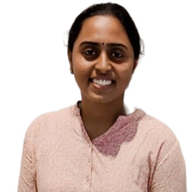

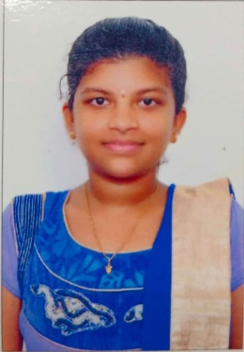
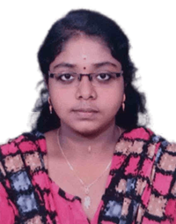
AARTHY.S.K
CB.SC.P2CSE23002
cb.sc.p2cse23002@cb.students.amrita.edu
HEMAPRIYA.R
CB.SC.P2CSE23007
cb.sc.p2cse23007@cb.students.amrita.edu
B.C.SAI VYSHNAVI
CB.SC.P2AIE23002
cb.sc.p2aie23002@cb.students.amrita.edu
PRIYADHARSHINI.N
CB.SC.P2AIE23010
cb.sc.p2aie23010@cb.students.amrita.edu

Slide 3
AGENDA
Introduction
Literature survey
Challenges
Dataset description
Methodology
Data analysis
ML model
DL model
Explainable AI
Conclusion
Future Enhancement

Slide 4
INTRODUCTION
The AI-Powered Nutrition Analyzer in Fruits using Machine Learning represents a groundbreaking venture at the intersection of technology and nutrition.
This project seeks to address this need by harnessing the power of Artificial Intelligence (AI) and Machine Learning (ML) to provide accurate and instant nutritional analysis of fruits.
Recent health surveys indicate that approximately 40% of the population is grappling with health challenges directly linked to poor dietary habits, leading to an increased prevalence of lifestyle-related diseases such as obesity and diabetes.
Within this demographic, nearly 70% of individuals lack sufficient awareness and understanding of the nutritional content in their food, with a specific gap identified in the knowledge regarding fruit consumption.
As societies worldwide grapple with the consequences of unhealthy eating habits, there is a collective need for accessible and user-friendly solutions that promote well-being.

Slide 5
LIST OF PRODUCTS SIMILAR TO THIS PROJECT
Product Name | URL | Features
Plate Joy | https://www.platejoy.com | Generates customized meal plans based on dietary preferences, restrictions, and health goals. Creates automated grocery lists corresponding to the selected meal plans. Provides detailed nutritional information for each meal, helping users track their intake.
MyFitnessPal | https://www.myfitnesspal.com/ | Allows users to log their daily food intake, including meals and snacks, to track calories and nutrients. Simplifies food logging by scanning product barcodes for quick entry. Connects users with a community for motivation, support, and shared experiences.

Slide 6
LIST OF PRODUCTS SIMILAR TO THIS PROJECT
Product Name | URL | Features
Yummly | https://www.yummly.com/ | Recommends recipes based on personal preferences, dietary restrictions, and past cooking history. Facilitates weekly meal planning with drag-and-drop functionality. Provides step-by-step instructions, timers, and video tutorials for selected recipes.
LIFE sum | https://lifesum.com/ | Recommends recipes based on personal preferences, dietary restrictions, and past cooking history. Facilitates weekly meal planning with drag-and-drop functionality. Provides step-by-step instructions, timers, and video tutorials for selected recipes.

Slide 7
List of Research Labs
Name of the lab | URL | Name of the Professor | Institute | Country

Slide 8
LITERATURE SURVEY

Slide 9
S.NO | RESEARCH PAPER | JOURNAL OF THE PAPER | ALGORITHM USED IN RESEARCH PAPER | RESEARCH GAP
1. | Title: A Robust Approach Using Fuzzy Logic for the Calories Evaluation of Fruits Authors: S. Veni, A. Krishna Sameera, V. Samuktha and R. Anand | SPIN | ANFIS (ADAPTIVE NEURO-FUZZY INFERENCE SYSTEM) - ANN | This paper aims in aiding dieticians, physicians, and patients to measure their daily calorie intake by manually capturing multiple fruits images and feeding them to calories measurement system which utilizes Adaptive Neuro-Fuzzy Inference System(ANFIS)
2. | Title: Image-based Fruit Recognition and Classification. Authors: A. Marin, E. Radoi | 21st RoEduNet Networking in Education and Research, 2022 | YOLOv3 (You Only Look Once, Version 3) | This paper proposes solution that used CNN for classifying fruits as either healthy or damaged. The algorithm was built on YOLOv3, a state-of the-art network for object detection in images that runs on the darkest architecture. The network was trained and evaluated on a newly collect and annotated dataset of over 400 images of 12 different fruits. The algorithm obtained a good classification accuracy of over 75%, considering the 12 double-states classes.
3. | Title: Fruit Detection and Recognition Based on Deep Learning for Automatic Harvesting: An Overview and Review Authors: F. Xiao, H. Wang, Y. Xu, R. Zhang | Agronomy 2023 | CNN (CONVOLUTIONAL NEURAL NETWORK) | The progress in machine learning (ML) has led to significant advancements in agricultural tasks. Due to its strong ability to extract high-dimensional features from fruit images, deep learning (DL) is widely used in fruit detection and automatic harvesting. Convolutional neural networks (CNN) in particular have demonstrated the ability to attain accuracy and speed levels comparable to those of humans in some fruit detection and automatic harvesting fields

Slide 10
S.NO | RESEARCH PAPER | JOURNAL OF THE PAPER | ALGORITHM USED IN RESEARCH PAPER | RESEARCH GAP
4. | Title: Machine Learning Based Approach on Food Recognition and Nutrition Estimation Authors: Zhidong Shen1 , Adnan Shehzad1 , Si Chen1 , Hui Sun2 , Jin Liu3 | SCIENCEDIRECT | CNN (CONVOLUTIONAL NEURAL NETWORK) | This paper proposes a deep learning model consisting of a convolutional neural network that classifies food into specific categories in the training part of the prototype system. The main purpose of the proposed method is to improve the accuracy of the pre-training model. The paper designs a prototype system based on the client server model. The client sends an image detection request and processes it on the server side. The prototype system is designed with three main software components, including a pre-trained CNN model training module for classification purposes, a text data training module for attribute estimation
5. | Title: Deep Learning and Computer Vision for Estimating Date Fruits Type, Maturity Level, and Weight Authors: Mohammed Faisal 1 , (Member, IEEE), FAHAD ALBOGAMY2 , Hebah Elgibreen3, Mohammed Algabri 4 And Fattoh Abdu Alqershi 4 | IEEE ACCESS | DEEP LEARNING ALGORITHM, NEURAL NETWORK, CLASSIFICATION ALGORITHM | The proposed system consists of three sub-systems: Dates maturity estimation system (DMES), type estimation system (DTES), and dates weight estimation system (DWES). We utilized four DL architectures, including ResNet, VGG-19, Inception-V3, and NASNet for both DMES and DTES and support vector machine (SVM) (regression and linear) for DWES. Using multiple performance metrics, DTES achieved maximum performance of 99.175% accuracy, an F1 score of 99.225%, 99.8% average precision, and 99.05% average recall. The maximum performance of DMES was 99.058% accuracy, F1 score of 99.34%, 99.64% average precision, and 99.08% average Recall. DWES achieved a maximum performance of 84.27% using SVM-Linear
6. | Title: Classification of fruits using Convolutional Neural Network. Authors: Roshani Raut, Anuja Jadhav, Chaitrali Sorte, Anagha Chaundhari | IEEE ACCESS | CNN (CONVOLUTIONAL NEURAL NETWORK) | In this Paper, The significance of fruit classification can also be observed among those with special dietary needs, who use it to assist them choose the appropriate types of fruits. Convolution Neural Networks (CNN) is one of the most advanced Deep Learning techniques, with image recognition taking the lead. We have supplied a dataset with a variety of fruits, and evaluated them based on pattern recognition. To produce the most refined prediction for fruit classification and disease detection, we used required convolution and pooling layers. When thoroughly analyzed by feature extraction and image segmentation, CNN demonstrated good accuracy as compared to other models. Our work is primarily focused on obtaining an classification of various fruits, the CNN model gives accuracy of 98.6%.

Slide 11
S.NO | RESEARCH PAPER | JOURNAL OF THE PAPER | ALGORITHM USED IN RESEARCH PAPER | RESEARCH GAP
7. | Title: Convolutional Neural Network based Rotten Fruit Detection using ResNet50. Authors: Chai C. Foong, Goh K.Meng, Lim L.Tze | IEEE | CNN (CONVOLUTIONAL NEURAL NETWORK), ResNet50 | In this Paper, To solve this problem, the proposed method is to apply the deep learning technique which is Convolutional Neural Networks (CNNs) for feature extraction and classification of rotten fruits. The types of fruits that will be detected and classified in this paper are banana, apple and orange. The validation accuracy obtained in this paper is 98.89%. The total duration of training stage is 212.13 minutes. Hence, the required time to classify single fruit image is approximately 0.2 Seconds.
8. | Title: A review on fruit recognition and feature evaluation using CNN Authors: D.N.V.S.L.S. Indira a , Jyothi Goddu b , Baisani Indraja c , Vijaya Madhavi Lakshmi Challa d , Bezawada Manasa | SCIENCE DIRECT | CNN (CONVOLUTIONAL NEURAL NETWORK) | The first thing addressed in this paper is Plant fruit recognition and its feature extraction, it plays vital role in Agriculture. The point is to construct an exact, quick and solid framework utilizing CNN realities. Automatic fruit detection may reduce human efforts (counting number of fruits and manual identification). The second thing addressed in this paper is plant classification to avoid similarities in many plant fruits. Fruit classification may help fruit sellers to identify and to differentiate various kind of fruits having same similarities. The proposed framework has applied convolutional Neural Net (CNN) to the undertaking of distinguishing natural fruit pictures. In any case, deep learning has been shown as of late to be an extremely incredible picture identification procedure, and CNN is a best in class way to deal with deep learning.
9. | Title: Deep learning accurately predicts food categories and nutrients based on ingredient statements Authors: Peihua Ma , Zhikun Zhang , Ying Li , Ning Yu, Jiping Sheng , Hande Küçük McGinty, Qin Wang a, Jaspreet K.C. Ahuja c | SCIENCE DIRECT | DEEP LEARNING ALGORITHM, MLP (MULTI-LAYER PRECEPTRON) | Determining attributes such as classification, creating taxonomies and nutrients for foods can be a challenging and resource-intensive task, albeit important for a better understanding of foods. In this study, a novel dataset, 134 k BFPD, was collected from USDA Branded Food Products Database with modification and labeled with three food taxonomy and nutrient values and became an artificial intelligence (AI) dataset that covered the largest food types to date. Overall, the Multi-Layer Perceptron (MLP)-TF-SE method obtained the highest learning efficiency for food natural language processing tasks using AI, which achieved up to 99% accuracy for food classification and 0.98 R2 for calcium estimation (0.93 ~ 0.97 for calories, protein, sodium, total carbohydrate, total lipids, etc.). The deep learning approach has great potential to be embedded in other food classification and regression tasks and as an extension to other applications in the food and nutrient scope.

Slide 12
S.NO | RESEARCH PAPER | JOURNAL OF THE PAPER | ALGORITHM USED IN RESEARCH PAPER | RESEARCH GAP
10. | Title: Fruits and Vegetables Recognition using YOLO Authors: R.S.Latha, G.R.Sreekanth, R.Rajadevi, S.K.Niveth, K.Ajith Kuma, V. Akash, S.Bhuvanesh, Pon Anbarasu | IEEE | CNN (CONVOLUTIONAL NEURAL NETWORK), DEEP LEARINING ALGORITHM, YOLOv4 TINY | The proposed work has applied the YOLO model for identifying different types of vegetables and fruits available in the vegetable market and hence the customer can know the updates the livestock of fruits and vegetables in that shop. The images of commonly used fruits and vegetables in India are collected from Google and also from Kaggle. The collected images are labeled using the Rob flow framework. To implement the proposed model, YOLOv4 –tiny model is chosen which is a super-fast object detector with better accuracy and is also most suitable for embedded devices. Further, this tiny model performs fast prediction in real-time video processing scenarios. The result of the proposed system is evaluated using the metric mean Average Precision (map). A high-value of map indicates that the model performs better is in its detection. Our YOLOv4-tiny model produced an map value of 51% with an inference time of 18 milliseconds.
11. | Title: Fruit-CNN: An Efficient Deep learning-based Fruit Classification and Quality Assessment for Precision Agriculture. Authors: Arnav Kumar, Rakesh Chandra Joshi, Malay Kishore Dutta, Martin Jonak, Radim Burget | IEEE | CNN (CONVOLUTIONAL NEURAL NETWORK) | In this Paper, The process of manually looking at and identifying the fruit type in crops can be a cumbersome task, the time from which could be put to better use. In this paper, a novel deep learning-based architecture Fruit-CNN has been proposed to identify the type of fruit and their quality assessment of real-world images in multiple visual variations which achieves a test accuracy of 99.6%. The proposed architecture takes minimal time to train the large dataset and test fruit images in comparison with state-of-the-art deep learning models which proves its wide applicability in precision agriculture. More images belonging to various classes can also be trained with fewer parameters which result in fast training of models and less processing time.
12. | Title: Real Time Riped Fruit Detection using Faster R-CNN Deep Neural Network Models. Authors: Sudha C, K.JaganMohan, M.Arulaalan | IEEE | DEEP LEARNING ALGORITHM(R-CNN), VCU16, ResNet50 and Inception V2 | Computer Vision and its associated emerging technology prove high potential in advanced agricultural applications. Recently Deep Learning algorithms are much more efficient in producing solution to Computer Vision Problems. In this paper, a literature review on deep learning algorithms and its uses in agriculture is done. Also, this paper reports the research work on autonomous harvesting system using IOT Technology. Fruit detection and plucking mechanism using Deep Learning Faster RCNN method is proposed. The accuracy rate of fruit recognition using VCG16, ResNet50 and InceptionV2 architectures are discussed. The mean average precision of fruit is 0.869. At the end, several problems related to recognition and localization are addressed.

Slide 13
S.NO | RESEARCH PAPER | JOURNAL OF THE PAPER | ALGORITHM USED IN RESEARCH PAPER | RESEARCH GAP
13. | Title: Fruit Classification using Optimized CNN. Authors: Arvinda Kushwaha | IEEE | CNN (CONVOLUTIONAL NEURAL NETWORK), K-NEAREST NEIGHBOR(KNN), | In this paper, Fruit classification is significant for a variety of reasons, including for persons with dietary restrictions to help them choose the appropriate fruit categories. There have been numerous machine learning methods for classifying fruits in the past. With its recognition and classification capabilities, deep learning has the potential to be a potent engine for generating results that can be put into practice. Deep learning approaches like CNNS showed tremendous promise for precisely categorized fruits. Basic fruit characteristics including color (RGB Color space), size, height, and width were retrieved from its image in order to use machine learning methods. KNN traditional machine learning methods were used on the features that were extracted. Convolutional neural network (CNN) technology offers a viable alternative to conventional machine learning techniques, according to the results. The TensorFlow backend was used to create the model. It received a 96.88% accuracy rating after 40 training epochs
14. | Title: Fruit Freshness Detection Using CNN. Authors: Mukund Kulkarni, Archana Chaudhari, Shekhar Shegokar, Krusha Rudrawar, Shaunk Joshi, Shruti Tibile, Isha Tayade | IEEE | CNN (CONVOLUTIONAL NEURAL NETWORK), RGB, DEEP LEARNING ALGORITHM. | In this paper, Quality of fruits and vegetables are most important as these are the main ingredients for our health. Freshness of fruits and vegetables are most important but segregation of rotten and fresh is time consuming, when done manually and degrades quality of fruits. Application based on Computer vision and image processing reduces this tedious and focuses on the quality of fruit and vegetable detection for a long period of time. The proposed method uses CNN to analyze and detect the variation and pattern for accurate classification.
15. | Title: Food Calorie and Nutrition Analysis System based on Mask R-CNN. Authors: Meng-Lin Chiang, Chia-An Wu, Jian-Kai Feng, Chiung-Yao Fang, Sei-Wang Chen | IEEE | DEEP LEARNING ALGORITHM(R-CNN) | The most effective way to prevent obesity is through food intake control, which involves understanding food ingestion, including the nutrients and calories of each meal. To assist with this issue, this study develops a food calorie and nutrition system that can analyze the composition of a food based on a provided image. Further, we introduce a newly collected dataset, Ville Cafe, for food recognition. This dataset contains 16 categories with 35,842 images, including salad, fruit, toast, egg, sausage, chicken cutlet, bacon, French toast, omelet, hash browns, pancake, ham, patty, sandwich, French fries, and hamburger. The system is based on a Mask Region-based Convolutional Neural Network (R-CNN) with a union postprocessing, which modifies the extracted bounding boxes and masks, without the nonminimum suppression (NMS), to provide a better result in both analytics and visualization. The recognition accuracy for the combination of Ville Cafe and the Food-256 Datasets was 99.86%, and the intersection over union (IoU) was 97.17%. The food weight estimation experiment included eight classes: salad, fruit, toast, sausage, bacon, ham, patty, and French fries. These classes respectively had 40, 40, 44, 40, 41, 49, 26, and 40 data points, adding up to 320 data points for the linear regression model. In the experimental results, the average absolute error was 8.22, and the average relative error was 0.13

Slide 14
CHALLENGES
Many existing studies may lack access to comprehensive and diverse datasets that cover a wide range of fruits, ripeness stages, and cultivation methods.
This gap hinders the development of robust machine learning models that can generalize well to different scenarios.
Some surveyed literature might not adequately address the challenges associated with real-time applications of AI-powered nutrition analyzers in dynamic settings, such as supermarkets or outdoor markets.
There is a research gap in optimizing models for quick and accurate assessments in real-world, time-sensitive environments.
The survey may highlight a lack of emphasis on ethical considerations, including privacy concerns related to the collection and analysis of user data for personalized nutrition recommendations.
Research gaps in this area need to be addressed to ensure responsible and transparent implementation.

Slide 15
PROBLEM STATEMENT
Develop an AI-Powered Nutrition Analyzer specifically designed for fruits using Machine Learning (ML) techniques. The primary objective is to create a robust model capable of accurately determining the nutritional content of diverse fruits based on their images.
The model should exhibit resilience to variations in fruit size, orientation, and lighting conditions," Convolutional Neural Network (CNN) techniques are involved to achieve this objective.
During model training, the current metrics, including a loss of 0.5830 and an accuracy of 0.7788, indicate the performance on the training set. The validation set metrics, with a loss of 0.6372 and an accuracy of 0.7244, provide insights into the model's generalization capabilities.
The dataset comprises images of fruits, with each image labeled as 'apple,' 'banana,' 'orange,' 'pineapple,' or 'watermelon.' The dataset is partitioned into a training set and a test set to facilitate model training and evaluation.
Fruits may appear in different sizes within images, requiring the model to adapt and accurately identify nutritional information regardless of scale.

Slide 16
MOTIVATION
The current health landscape underscores the critical need for precise nutritional assessments, particularly in the realm of fruits.
This project aspires to leverage the power of machine learning, specifically employing Convolutional Neural Networks (CNNs), to develop an automated system capable of detecting and analyzing nutrition in fruits.
The utilization of CNNs is well-suited for our dataset, consisting of a diverse collection of images representing various fruits.
The availability of vast datasets, including images obtained through sensors and imaging technologies, combined with open-access nutritional databases, has paved the way for comprehensive fruit nutrition analysis.

Slide 17
DATASET
The data contains images of Fruits, that can be used for classification using deep learning.
The dataset has 5 class of fruits:
Apple
Banana
Orange
Watermelon
Pineapple

Slide 18
SPLIT RATIO OF THE DATASET:
The available dataset consists of 1000 of Fruit Images for Training and Testing the data. Images contain different angles, texture, color, shape of specific fruit.
The dataset also trained to eliminate the background and identify only the specific fruit and also, we use h5 file in this project dataset.
Training- 525 images average (Total- 2626)
Testing- 210 images average (Total-1055)
Prediction- 100 images.

Slide 19
BLOCK DIAGRAM

Slide 20
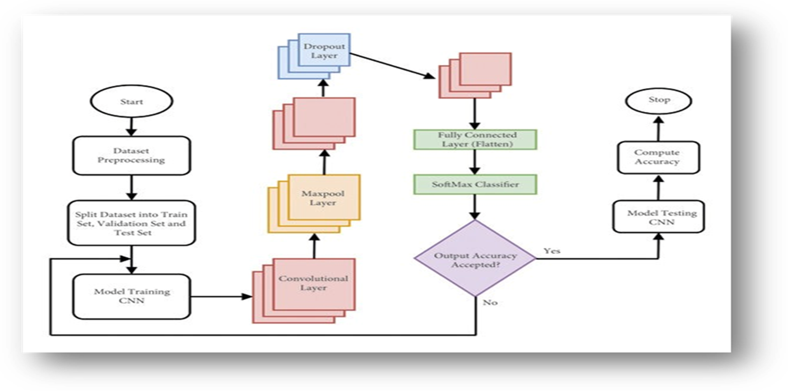

Slide 21
Methodology
Section (i): Data Analysis (PRE-PROCESSING)
Section (ii): Machine Learning Model (REGRESSION, CLASSIFIERS)
Section (iii): Deep Learning Model
Section (iv): Explainable AI

Slide 22
DATA ANALYSIS (PRE-PROCESSING)

Slide 23
DATASET ANALYSIS
Approach | Approach Followed | Name of the student Contributed
Dataset Generation
Noise Removal
Pre-processing

Slide 24
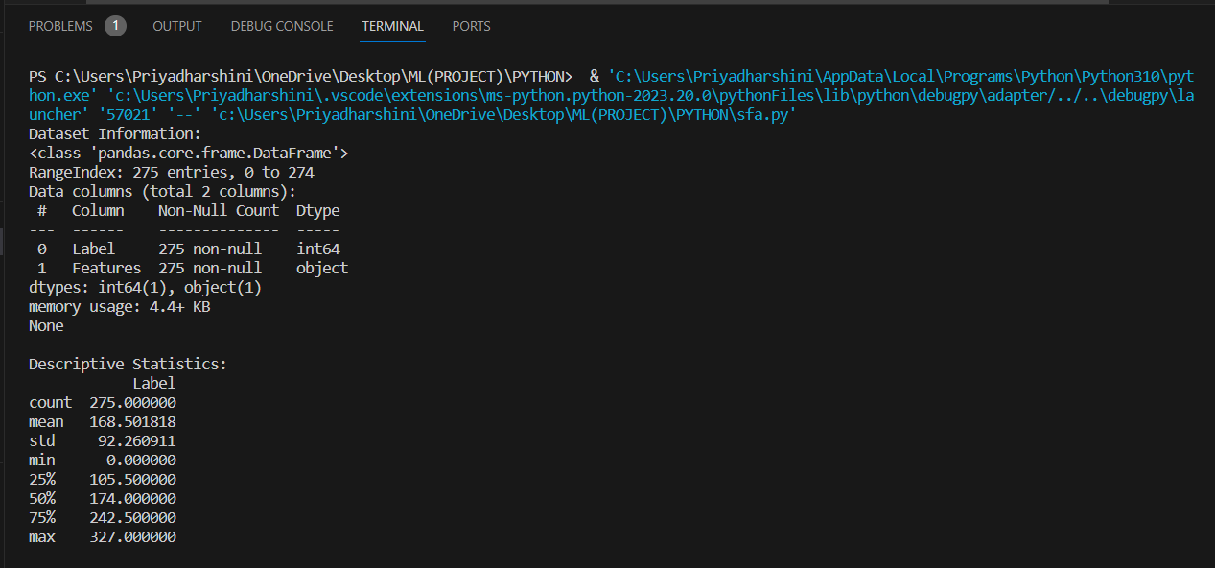
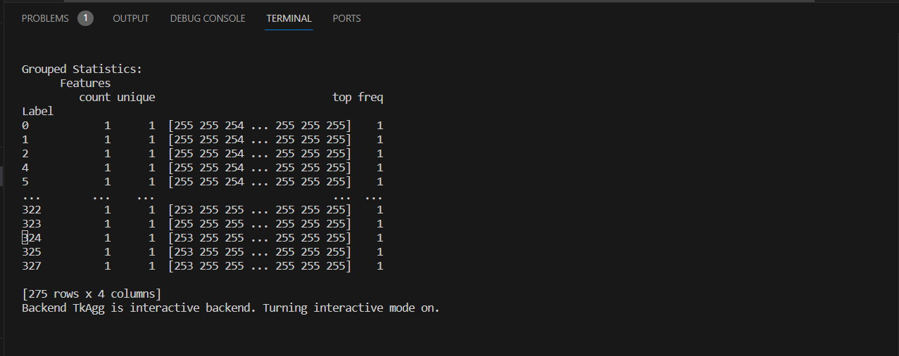
STATISTICAL FEATURE ANALYSIS
Performing statistical feature analysis on an image dataset is a crucial step in understanding, processing, and utilizing image data effectively.
This practice is motivated by several key reasons. The spread of values, as indicated by the standard deviation, suggests a diverse set of features, and further exploration may reveal patterns or trends within the dataset.
The presence of minimum and maximum values highlights the range of feature values, which is crucial for designing appropriate preprocessing steps and selecting relevant features for analysis.
We infer from the above dataset that the average value of the feature is 168.6 and this value spreads over a standard deviation value of 92.26 which depicts the diversity of the feature.

Slide 25
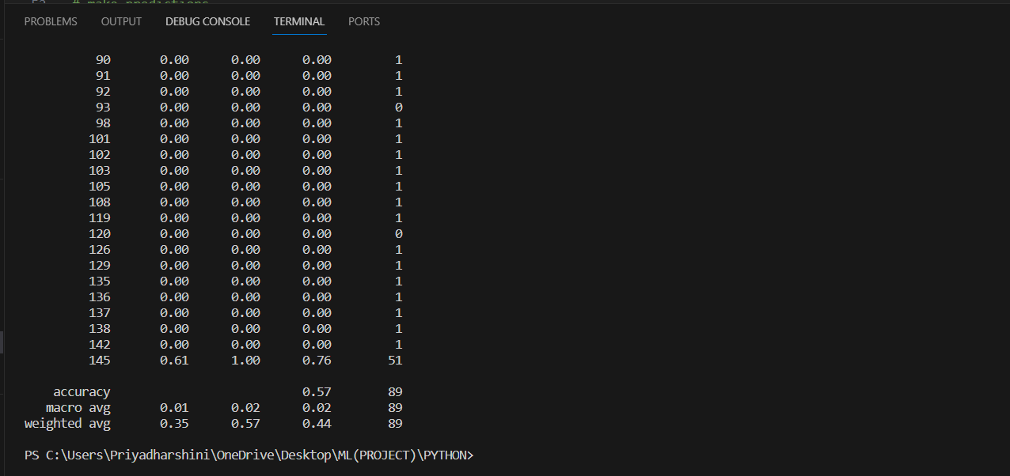
SMOTE ALGORITHM
This Algorithm is used to Remove the Noise for the Dataset.
The SMOTE (Synthetic Minority Over-sampling Technique) algorithm is used to address imbalances in datasets, particularly when one class is underrepresented.
This process is repeated until a desired balance is achieved. As for evaluation metrics, accuracy measures the overall correctness of predictions, while macro-average and weighted average assess classification performance.
Macro-average treats each class equally, irrespective of size, while weighted average considers class sizes. Applying SMOTE can enhance accuracy, but it's crucial to examine class-specific metrics, especially for the minority class, to fully understand the model's performance

Slide 26
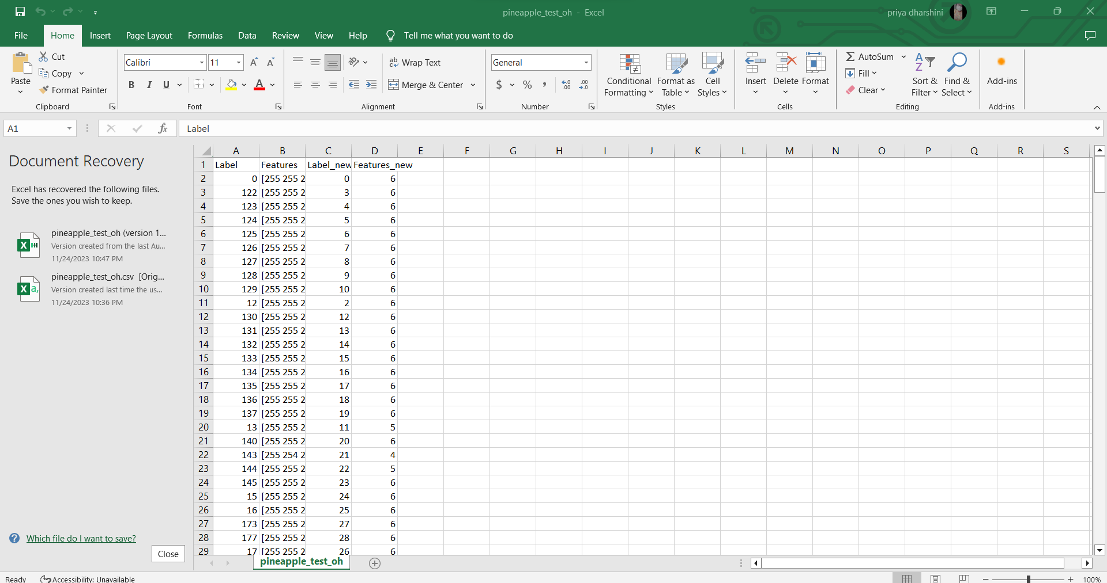
ONE-HOT ENCODING
One-hot encoding is a way to represent categorical data in a format that's easy for computers to understand.
Imagine you have a list of categories, like colours (red, blue, green). In one-hot encoding, each category is assigned a unique binary value. For example, red might be represented as [1, 0, 0], blue as [0, 1, 0], and green as [0, 0, 1].
Each category gets its own "slot" in a binary array, and only one of these slots is "hot" (set to 1) at a time, indicating the presence of that category.
This encoding is useful for machine learning algorithms that require numerical input, as it transforms categorical data into a format that retains the distinctiveness of each category without implying any ordinal relationship between them.

Slide 27
MACHINE LEARNING MODEL (REGRESSION, CLASSIFIERS)

Slide 28
MACHINE LEARNING MODEL
S.NO | Algorithm Name | Student contributed
1. | LINERA
2 | LOGISTIC
3. | RIDGE AND LASSO
4. | K-MEANS WITH KNN
5. | FUZZY C-MEANS WITH KNN
6. | K-MEANS WITH SVM
7. | BAYESIAN
8. | NAÏVE BAYES
9. | DECISION TREE

Slide 29
REGRESSION
Regression is a statistical technique used for modeling the relationship between a dependent variable and one or more independent variables.
The goal of regression analysis is to understand and quantify the relationship between variables, predict the value of the dependent variable based on the values of the independent variables, and identify the strength and nature of the relationships.
regression helps us examine the extent to which changes in one variable are associated with changes in another.
The variable we are trying to predict is called the dependent variable, while the variables we use to make predictions are called independent variables or predictors.

Slide 30
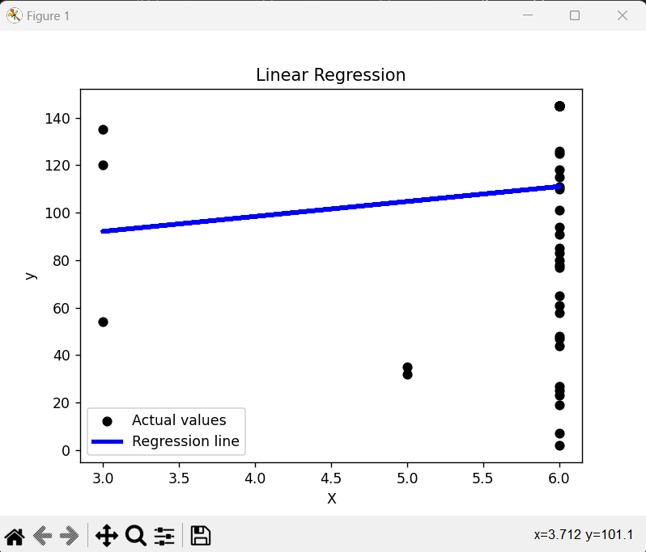
LINEAR REGRESSION
The regression line is calculated using linear regression, which is a statistical method used to model the relationship between a dependent variable (y) and an independent variable (x).
The equation of the regression line is
y = mx + b
where m is the slope and b are the y-intercept.
In this figure, the regression line is represented by the equation
y = 101.1 + 0.0001(x - 3.712).
The slope of the line is 0.0001, and the y-intercept is 101.1. The value of x at which the regression line intersects the y-axis is 3.712.

Slide 31
TABLE OF PARAMETER SET IN THE MODEL
Parameter Name | Purpose | Value
Precision | Precision is a measure of the accuracy of the positive predictions made by the model. | 0.16
Re-call | Recall measures the ability of the model to capture all the relevant instances of the positive class. | 0.13
F1-score | F1-score is the harmonic mean of precision and recall. | 0.12
Support | Support is the number of actual occurrences of the class in the specified dataset. | 56
TABLE OF PARAMETERS EVALUATED IN THE MODEL
Parameter Name | Purpose | Value
Accuracy | Accuracy provides an overall measure of correct predictions. | 0.593
Macro-average | Macro-average treats each class equally, making it suitable when all classes are considered equally important. | 0.125
Weighted-average | Weighted-average class sizes, making it suitable for imbalanced datasets where some classes are more prevalent than others. | 0.53

Slide 32
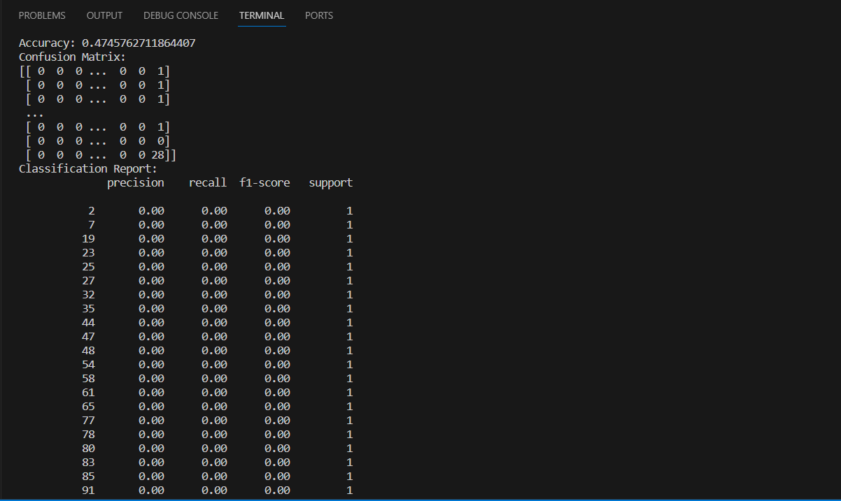
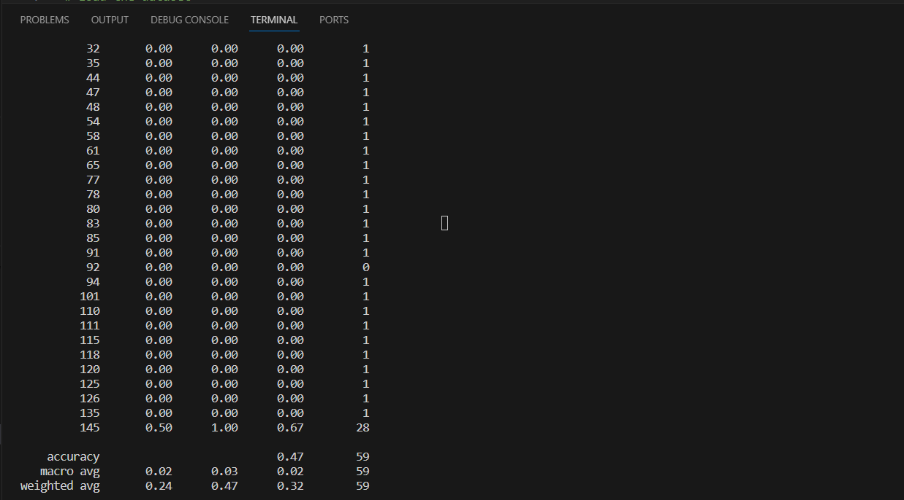
LOGISTIC REGRESSION
The output includes the accuracy of the model, confusion matrix, classification report, and precision, recall, and f1-score metrics.
The accuracy of the model is 0.47, which means that the model's predictions are correct about 47% of the time. The confusion matrix shows the number of correct and incorrect predictions made by the model for each class.
The classification report displays the precision, recall, and f1-score metrics for each class. Precision is the ratio of true positive predictions to the total predicted positives.
Recall is the ratio of true positive predictions to the total actual positives. The f1-score is the harmonic mean of precision and recall.
In this output, the classification report shows that the model has not made any correct predictions for any of the classes, as the precision, recall, and f1-score values are all 0.00.

Slide 33
TABLE OF PARAMETER SET IN THE MODEL
Parameter Name | Purpose | Value
Precision | Precision is a measure of the accuracy of the positive predictions made by the model. | 0.24
Re-call | Recall measures the ability of the model to capture all the relevant instances of the positive class. | 0.47
F1-score | F1-score is the harmonic mean of precision and recall. | 0.32
Support | Support is the number of actual occurrences of the class in the specified dataset. | 83
TABLE OF PARAMETERS EVALUATED IN THE MODEL
Parameter Name | Purpose | Value
Accuracy | Accuracy provides an overall measure of correct predictions. | 0.47
Macro-average | Macro-average treats each class equally, making it suitable when all classes are considered equally important. | 0.02
Weighted-average | Weighted-average class sizes, making it suitable for imbalanced datasets where some classes are more prevalent than others. | 0.37

Slide 34
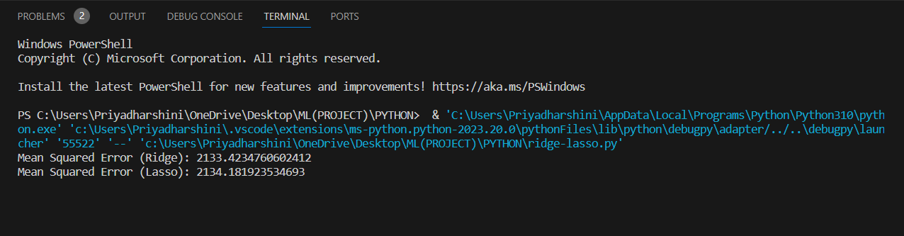
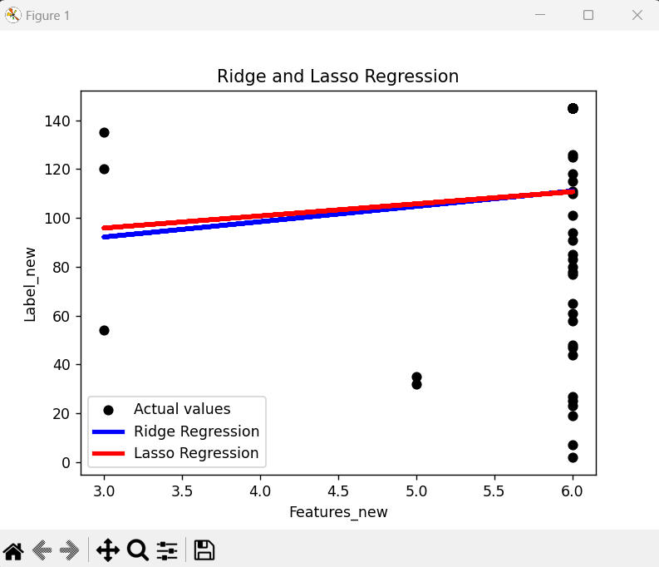
RIDGE & LASSO REGRESSION
The first subplot, "Ridge Regression," shows the actual values of the dependent variable (y) as dots on the y-axis and the predicted values from Ridge Regression as a solid line. The actual values range from 0 to 140, and the predicted values range from 0 to 110.
The second subplot, "Lasso Regression," shows the actual values as dots on the y-axis and the predicted values from Lasso Regression as a dashed line. The actual values range from 0 to 140, and the predicted values range from 0 to 120.
The third subplot, "Ridge and Lasso Regression," shows the actual values as dots on the y-axis and the predicted values from Ridge and Lasso Regression as a dotted line. The actual values range from 0 to 140, and the predicted values range from 0 to 110.

Slide 35
COMPARISON OF REGRESSION
Parameter → Regression | MSE | Precision | Re-call | F1-score | Support
Linear | 2100.42 | 0.16 | 0.13 | 0.12 | 56
Logistic | 2156.56 | 0.24 | 0.47 | 0.32 | 83
Ridge | 2133.37 | 0.35 | 0.34 | 0.14 | 67
Lasso | 2134.18 | 0.46 | 0.23 | 0.52 | 72

Slide 36
CLASSIFIERS
Classifiers are algorithms or models that are used in machine learning to categorize or classify input data into different predefined classes or categories.
The process of classification involves training a model on a labeled dataset, where each data point is associated with a known class label.
The trained model can then be used to predict the class labels of new, unseen data based on the patterns it learned during training.
Classifiers are a type of supervised learning, where the algorithm learns from labeled examples to make predictions on new, unseen data.

Slide 37
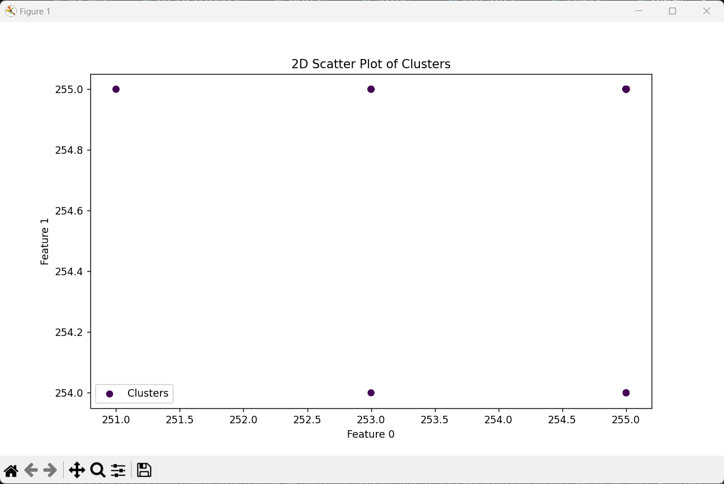
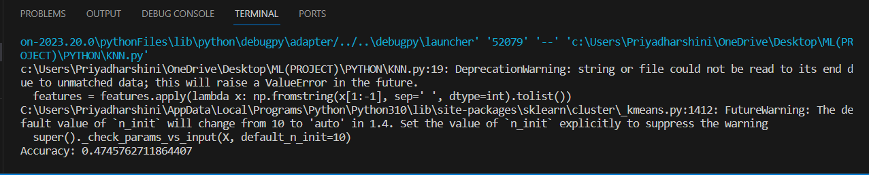
K-MEANS WITH KNN
For k-means, key hyperparameters include the number of clusters (k) and the initialization method, while for KNN, the number of neighbours (k) and the distance metric are crucial.
A common approach is to use techniques like grid search or random search to systematically explore various combinations of these hyperparameter values.
The goal is to find the set of hyperparameters that maximizes the overall clustering and classification performance.
This iterative process helps identify the optimal configuration, enhancing the accuracy and efficiency of the combined k-means and KNN approach in unsupervised and supervised learning tasks.

Slide 38
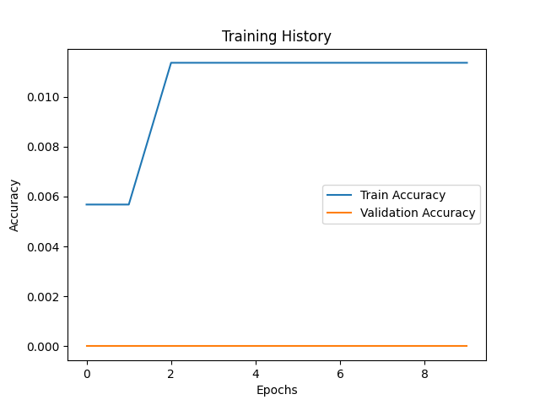
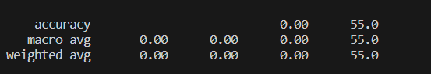
FUZZY C-MEANS WITH KNN
Hyperparameter tuning for a fuzzy classifier involves optimizing the parameters that govern the behaviour of the fuzzy system to enhance its performance.
These hyperparameters include membership function parameters, rule base settings, and defuzzification strategies.
A common approach is to use techniques like grid search or random search to systematically explore the hyperparameter space and identify the combination that yields the best classification results.
Additionally, methods such as cross-validation can be employed to assess the model's generalization capabilities.
The goal is to fine-tune the fuzzy classifier's hyperparameters to achieve optimal balance and accuracy in capturing the underlying patterns in the data, ultimately improving its predictive capabilities.

Slide 39
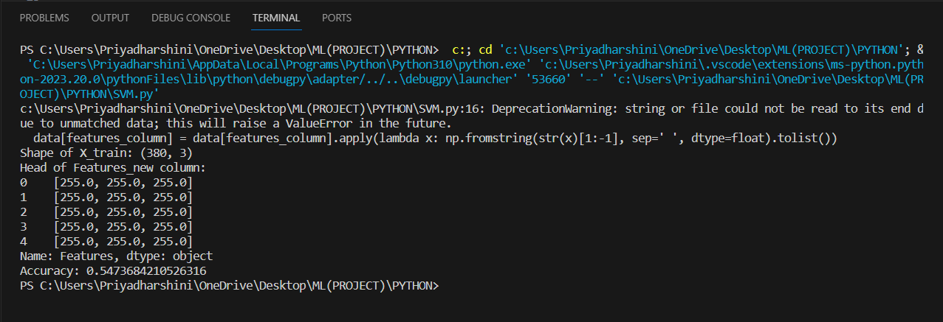
K-MEANS WITH SVM
Hyperparameter tuning consists of finding a set of optimal hyperparameter values for a learning algorithm while applying this optimized algorithm to any data set.
That combination of hyperparameters maximizes the model's performance, minimizing a predefined loss function to produce better results with fewer errors.
SVM also has some hyper-parameters (like what C or gamma values to use) and finding optimal hyper-parameter is a very hard task to solve.
But it can be found by just trying all combinations and see what parameters work best.
The main idea behind it is to create a grid of hyper-parameters and just try all of their combinations (hence, this method is called Gridsearch, But don’t worry! we don’t have to do it manually because Scikit-learn has this functionality built-in with GridSearchCV.

Slide 40
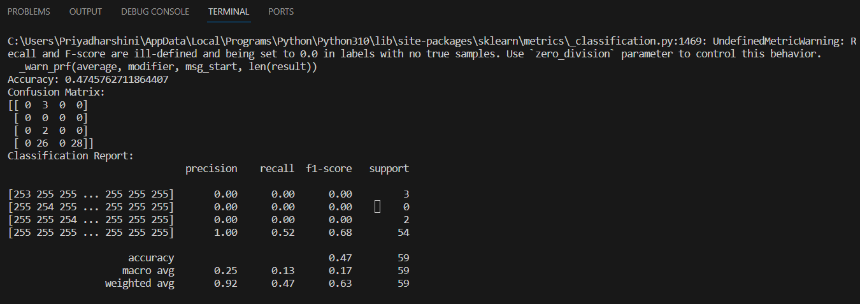
BAYESIAN CLASSIFIER
This is the output of a machine learning model used for fruit nutrition analysis. The output includes the accuracy of the model, confusion matrix, classification report, and precision, recall, and f1-score metrics.
Use zero division parameter to control this behavior. This warning indicates that the model has encountered labels with no true samples, and the recall and f1-score metrics have been set to 0.0.
The accuracy of the model is 0.47, indicating that the model's predictions are correct only 47% of the time. The confusion matrix shows the number of true positives, false positives, true negatives, and false negatives for each class.
The classification report displays the precision, recall, and f1-score metrics for each class. However, since there are no true samples for some classes, the precision, recall, and f1-score metrics are ill-defined and set to 0.0.

Slide 41
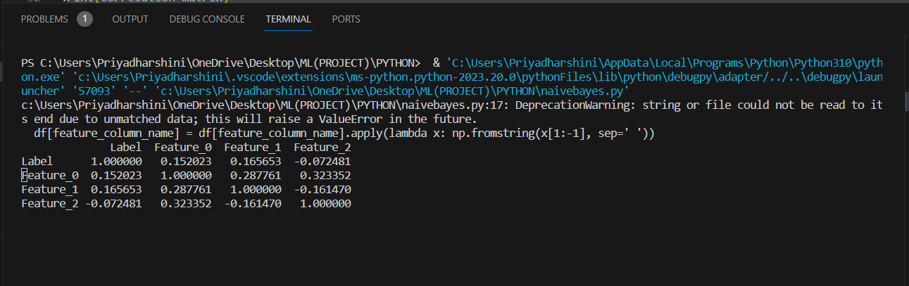
NAÏVE BAYES CLASSIFIER
The debug console output also shows the first few rows of the "df" Data Frame, which contains a "Label" column and three "Feature" columns with numerical values.
The script then creates a new Data Frame named "expanded features" by separating the "Features" column into individual columns named "Feature_0", "Feature_1", and "Feature_2".
The script then concatenates the "expanded features" Data Frame with the original "df" Data Frame and drops the original "Features" column.
The script then performs statistical feature analysis on the updated Data Frame, such as generating a correlation matrix.

Slide 42
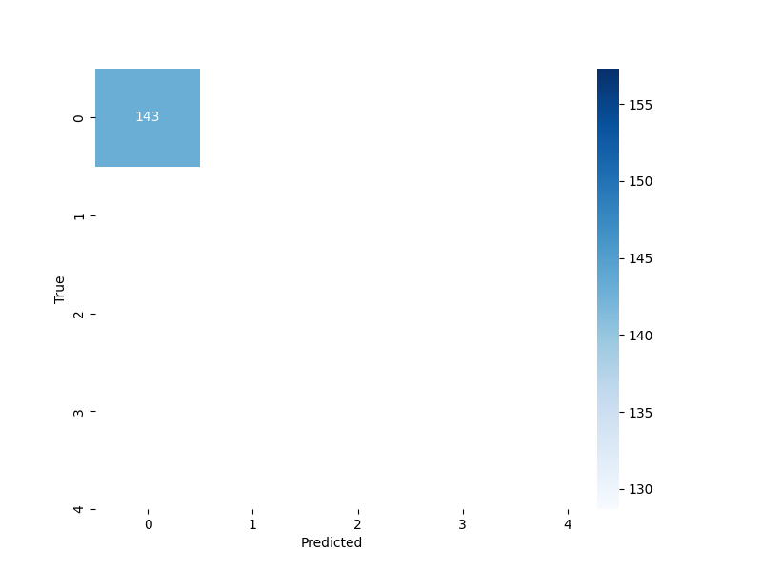
DECISION TREE
The first row shows that the model correctly predicted the value of the target variable for the first data point, which was 0.
The second row shows that the model predicted a value of -3 for the second data point, while the true value was 155, indicating an error in the prediction.
Similarly, the model predicted a value of -150 for the 14th data point, while the true value was 2, indicating a large error in the prediction.
Overall, this matrix shows the accuracy of the model in predicting the target variable for different data points.
The numbers in the second column of the first row indicate that the first few data points have a target value of 0, while the numbers in the second column of the second row indicate that the second data point has a target value of 155.
The numbers in the first column of the first row indicate that the first data point is part of the training data, while the "Predicted" column shows the values predicted by the model for those same data points.

Slide 43
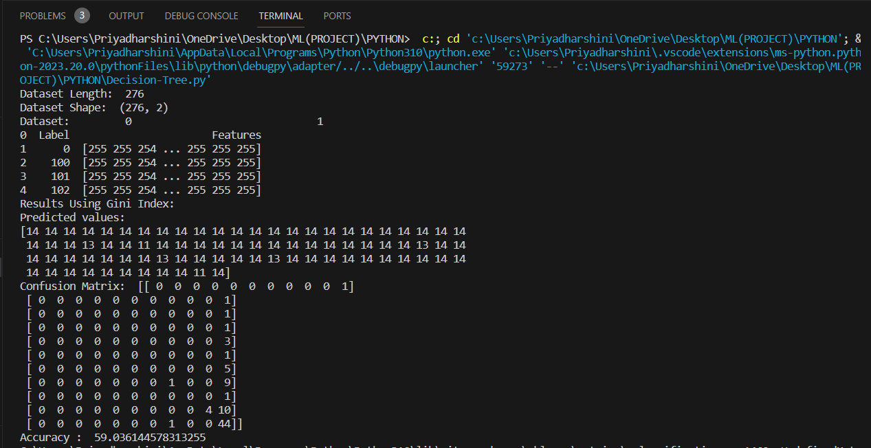
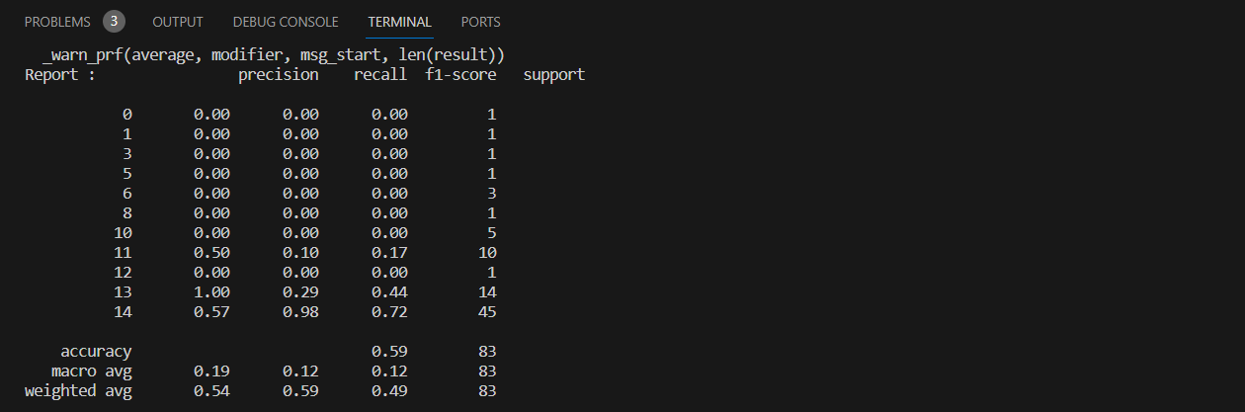

Slide 44
COMPARISONS OF CLASSIFIER:
S. No | ALGORITHM | PRECISION | RECALL | F1-SCORE | SUPPORT | ACCURACY
1. | K-Means with KNN | 0.89 | 0.34 | 0.54 | 67 | 0.474
2. | C-Means with KNN | - | - | - | - | 0.1276
3. | K-Means with SVM | - | - | - | - | 0.5470
4. | Bayesian Classifier | 0.92 | 0.47 | 0.63 | 59 | 0.4745
5. | NaïveBayes Classifier | 0.92 | 0.47 | 0.63 | 59 | -
6. | Decision Tree | 0.54 | 0.59 | 0.49 | 83 | 59.0314

Slide 45
DEEP LEARNING MODEL

Slide 46
Deep Learning Model
S.NO | Algorithm Name | Student contributed
1. | ALEX-NET
2. | LSTM
3. | GRU

Slide 47
DEEP-LEARNING
Deep learning is a subfield of machine learning that focuses on the use of neural networks to model and solve complex problems.
Neural networks, inspired by the structure and functioning of the human brain, consist of interconnected nodes (neurons) organized into layers.
Deep learning specifically refers to the use of deep neural networks, which are neural networks with multiple layers, often called deep neural networks or deep networks.
Deep learning has achieved remarkable success in various domains, including computer vision, speech recognition, natural language processing, and reinforcement learning.
Its ability to automatically learn complex representations from data has contributed to breakthroughs in tasks that were traditionally challenging for traditional machine learning methods.

Slide 48
ALEX-NET
This appears to be a table showing the training history of a machine learning model, specifically the Alex-Net architecture.
The leftmost column shows the number of epochs, which is the number of times the learning algorithm will work through the entire training dataset.
The second column shows the accuracy of the model on the training data, while the third column shows the accuracy on the validation data.
The validation accuracy is important because it gives an indication of how well the model is likely to perform on new, unseen data.
The first row of the table shows that after 1 epoch, the training accuracy was 0.5 and the validation accuracy was 0.4. The second row shows that after 2 epochs, the training accuracy was 0.5 and the validation accuracy was 0.4. This suggests that the model is not improving its accuracy on the validation data, which could indicate overfitting on the training data.
The table also includes a column for false negatives (FN), which are instances where the model fails to predict a positive class when the true label is positive. A high number of false negatives can indicate that the model is not sensitive enough to detect instances of the positive class.
Overall, this table provides important information about the performance of the Alex-Net model during training, and can help to identify potential issues such as overfitting or poor sensitivity.

Slide 49
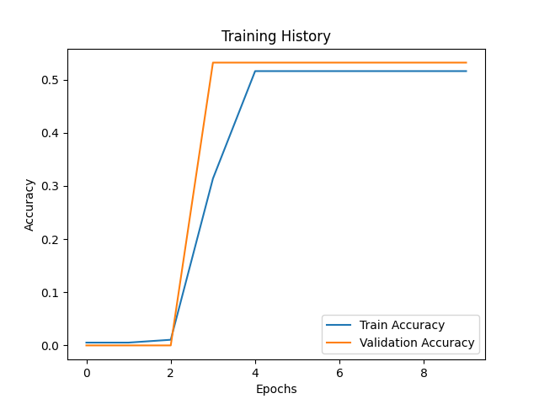
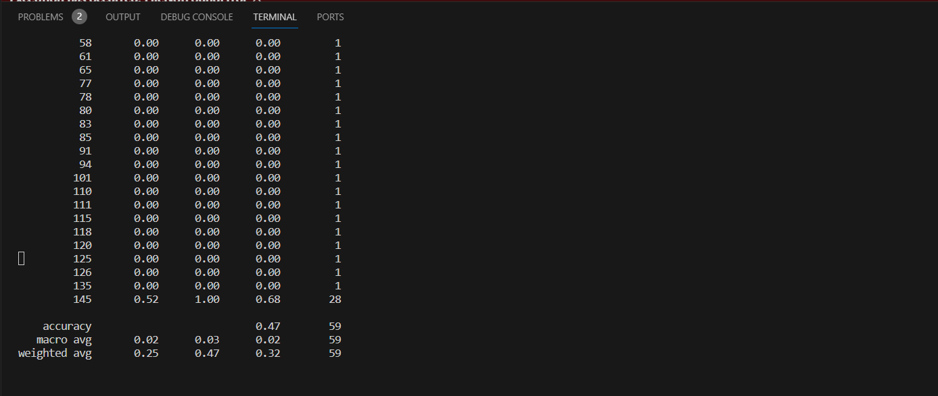

Slide 50
LSTM
The given output appears to be the training history of a machine learning model using LSTM (Long Short-Term Memory) on a time series dataset.
The output shows the loss and accuracy values for each epoch during training and validation.
The model is trained for 10 epochs, and the output displays the loss and accuracy values for each epoch. The val_loss and val_accuracy values indicate the performance of the model on the validation set during each epoch. The last two lines show the final test loss and accuracy.
The training loss decreases steadily over the epochs, while the validation loss decreases until the seventh epoch, after which it starts to increase again.
This suggests that the model is starting to overfit the training data after the seventh epoch. The accuracy values are relatively low, indicating that the model is having difficulty predicting the correct outputs.
The final test loss is -3.6363 and the accuracy is 0.0182, which suggests that the model is not performing well on the test set.
Overall, the output suggests that the LSTM model may need further tuning, such as adjusting the learning rate or adding regularization, to improve its performance.

Slide 51
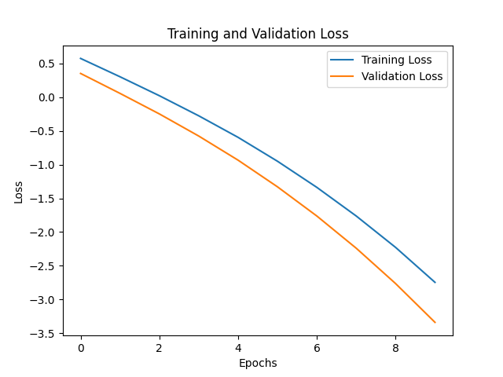
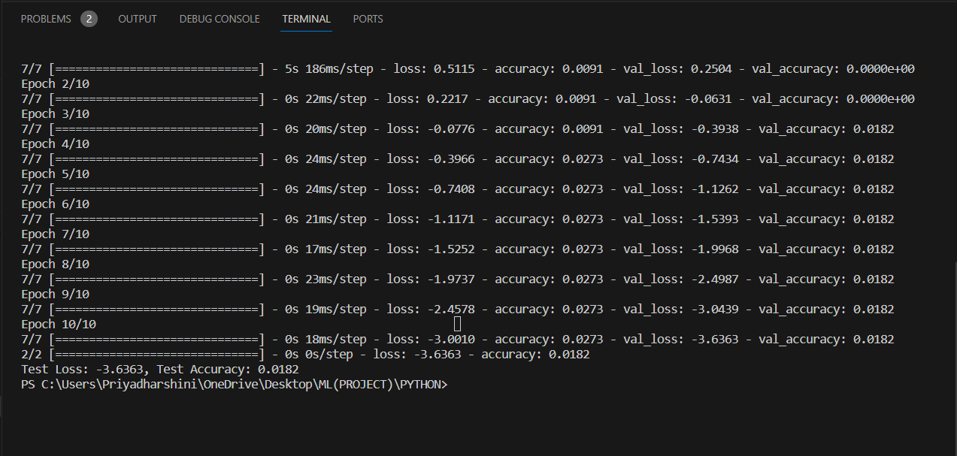

Slide 52
GRU
This is the output of a training session for a machine learning model using the GRU (Gated Recurrent Unit) architecture.
The output shows the progression of the model as it trains through multiple epochs, which are passes through the entire dataset.
The model's loss and accuracy are reported for both the training data and the validation data after each epoch.
The loss is a measure of how well the model is fitting the data, with lower values indicating better performance.
The accuracy measures the proportion of correct predictions made by the model, with higher values indicating better performance.
The output then shows the results for each epoch. For example, in the first epoch, the model's loss on the training data is 0.5243 and the accuracy is 0.0091. On the validation data, the model's loss is 0.2227 and the accuracy is 0.0000e+00, which is equivalent to 0.

Slide 53
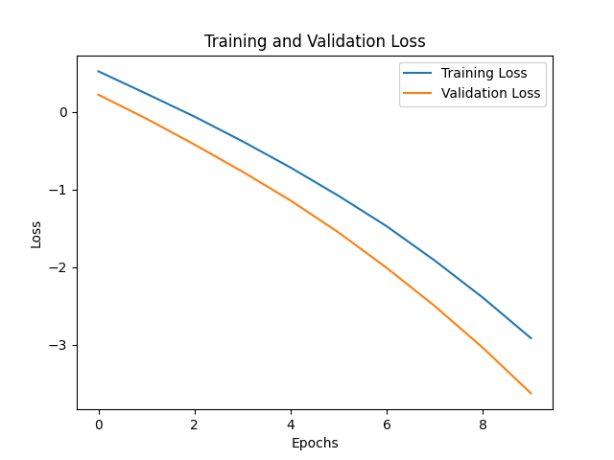
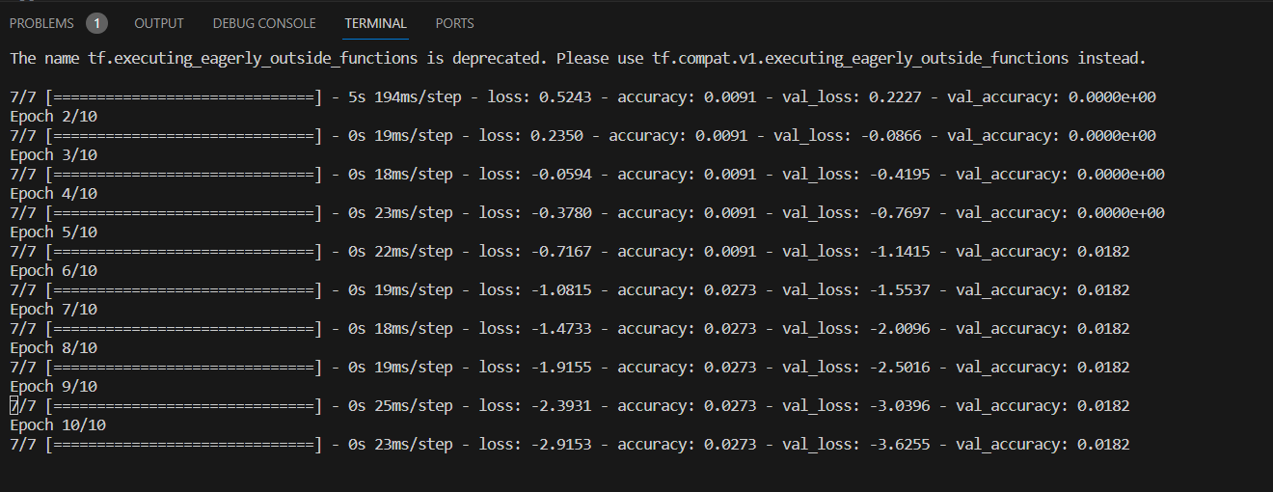

Slide 54
EXPLAINABLE-AI

Slide 55
EXPLAINABLE AI
Algorithm Name | Student contributed
CNN
Explain the architecture chosen and discuss how interpretation can be done.

Slide 56
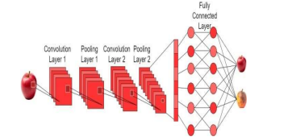
ARCHITECTURE DIAGRAM

Slide 57
CNN
The model has three layers of Conv2D (convolutional layer), which is used for extracting features from the input image data through a set of filters.
The first Conv2D layer has 32 filters, each with a kernel size of 3x3, and it takes an input image of shape (64, 64, 3) (i.e., a 64x64 color image with three color channels).
The output shape of the first Conv2D layer is (None, 62, 62, 32), where "None" represents the batch size, which is not fixed.
The second layer is a MaxPooling2D layer, which is used for down sampling the spatial dimensions of the feature maps, thereby reducing the computational cost.
The third layer is another Conv2D layer with 32 filters, and it takes the output of the MaxPooling2D layer as its input.
The final layers are a Flatten layer, which is used for flattening the feature maps into a single vector, and two Dense layers.
The first Dense layer has 128 neurons and uses the rectified linear unit (ReLU) activation function, while the second Dense layer has 5 neurons (corresponding to the number of classes in the multi-class classification problem) and uses the softmax activation function for producing the final class probabilities.
The output also shows the total number of parameters (weights) in the model, which is 813,733, and the trainable and non-trainable parameters.

Slide 58
EXPERIMENTAL SET UP
S.NO | PARAMETER NAME | VALUES
1 | Learning Rate | 0.001
2 | Number of Batches | (64, 64, 3)
3 | Batch Size | 5
4. | Number of Convolution Layers | 7
5 | Number of Kernels/Filter | 32
6 | Kernel Size | (3x3)
7 | Stride | 1
8 | Rescale | 1./255
9 | Pooling Type | Max_pooling2D
10 | Pooling Size | (2, 2)
11 | Activation Function | ‘relu’, ’softmax’
12 | Dense units | 5 or 128
13 | Shear_range | 0.2
14 | Loss Function | 0.5830
15 | Input Shape | (64, 64)

Slide 59
PERFORMANCE MEASURES
S.No | Measure/Metric | Unit
1 | Accuracy | 0.4745762711864407
2 | Precision | 0.135
3 | Recall | 0.25
4 | Sensitivity | 0.276
5 | Specificity | 59

Slide 60
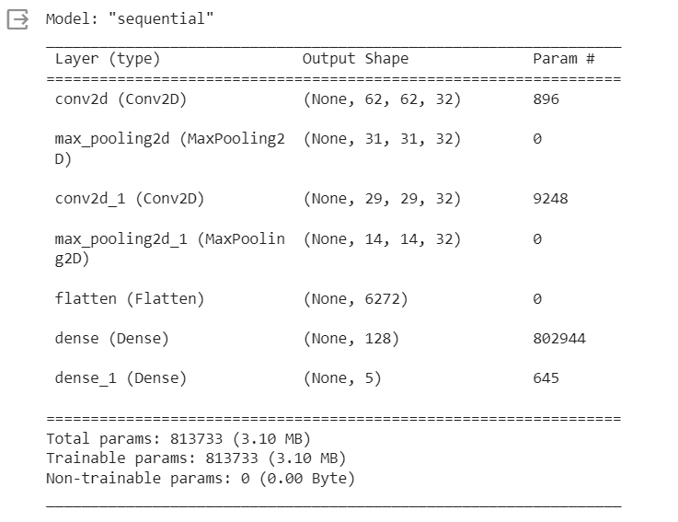
OPTIMIZER – Adam
LOSS – Spare_Categorical_crossentropy
ACTIVATION – SoftMax, relu
EPOCH – 50
REGULARIZATION – Drop out
MAXPOOLING – pool_size

Slide 61
S.NO | EPOCH | TRAINING ACCURACY | TRAINING LOSS | VALIDATION ACCURACY | VALIDATION LOSS
1. | 1-10 | 0.6032 | 0.6833 | 0.5609 | 0.7533
2. | 10-20 | 0.6810 | 0.7190 | 0.6499 | 0.8132
3. | 20-30 | 0.7188 | 0.7621 | 0.6945 | 0.8556
4. | 30-40 | 0.7567 | 0.8188 | 0.7154 | 0.8900
5. | 40-50 | 0.7788 | 0.8830 | 0.7244 | 0.9372

Slide 62
Conclusion and Future Enhancement
This paper proposes a model for analyzing and detecting healthy foods using image recognition and nutrient classification techniques.
It aims to develop an automated system to classify foods as this task is often subjective and labor-intensive when done by humans.
Future research focuses on improving fruit vision detection systems' accuracy, speed, robustness, and generalization while minimizing complexity and cost.
The goal is to provide a reference for studies in fruit detection and recognition based on deep learning for automatic harvesting.
Advanced DL models with parameter tuning will be used to enhance detection and classification accuracy while reducing memory usage.
The focus will be on expanding datasets to include a broader range of fruit species and diverse images, potentially incorporating synthetic images for training.
A shift towards identifying defective and damaged fruits

Slide 63
REFERENCES
S. Veni, A. Krishna Sameera, V. Samuktha and R. Anand, "A Robust Approach Using Fuzzy Logic for the Calories Evaluation of Fruits," 2021 8th International Conference on Signal Processing and Integrated Networks (SPIN), Noida, India, 2021, pp. 738-744, doi: 10.1109/SPIN52536.2021.9566022.
Zhidong Shen, Adan Shehzad, si Chen, Hui sun, Jin Liu: Machine Learning Based Approach on Food Recognition and Nutrition Estimation. 2019 International Conference on Identification, Information and Knowledge in the Internet of Things(IIKI2019).https://www.sciencedirect.com/journal/procedia-computer-science.
S. Banerjee and A. C. Mondal, "Nutrient Food Prediction Through Deep Learning," 2021 Asian Conference on Innovation in Technology (ASIANCON), PUNE, India, 2021, pp. 1-5, doi: 10.1109/ASIANCON51346.2021.9545014.
Xiao, F.; Wang, H.; Xu, Y.; Zhang, R. Fruit Detection and Recognition Based on Deep Learning for Automatic Harvesting: An Overview and Review. Agronomy 2023, 13,1625. https://doi.org/10.3390/agronomy13061625

Slide 64
REFERENCES
H. B. Ünal, E. Vural, B. K. Savaş and Y. Becerikli, "Fruit Recognition and Classification with Deep Learning Support on Embedded System (fruitnet)," 2020 Innovations in Intelligent Systems and Applications Conference (ASYU), Istanbul, Turkey, 2020, pp. 1-5, doi: 10.1109/ASYU50717.2020.9259881.
Stergios Christodoulides, Marios Anthimopoulos, and Stavroula Mougiakakou: Food Recognition for Dietary Assessment Using Deep Convolutional Neural Networks. https: link.springer.com.
[Mohammed Ahamed Subhi, (Member, IEEE), Sawal Hamid Ali,(Member, IEEE), And Mohammed Abul Ameer Mohammed: Vision-Based Approaches for Automatic Food Recognition and Dietary Assessment: A Survey.IEEE Access digital Object Identifier 10.1109/ACCESS.2019.2904519.
Ying Wang, Jianbo Wu, Hui Deng and Xianghui Zeng: Food Image Recognition and Food Safety Detection Method Based on Deep Learning
Dr. Subarna Shakya: Analysis of Artificial Intelligence based Image Classification Techniques. Journal of Innovative Image Processing (JIIP) (2020) Vol.02/ No. 01, Pages: 44-54, DOI: https://doi.org/10.36548/jiip.2020.1.00544 ISSN: 2582- 4252 (online)

Slide 65
REFERENCES
P. Pouladzadeh, S. Shirmohammadi and R. Al-Maghrabi, "Measuring Calorie and Nutrition From Food Image," in IEEE Transactions on Instrumentation and Measurement, vol. 63, no. 8, pp. 1947-1956, Aug. 2014, doi: 10.1109/TIM.2014.2303533.
Mimma, Nur E Aznin & Ahmed, Sumon & Rahman, Tahsin & Khan, Riasat. (2022). Fruits Classification and Detection Application Using Deep Learning. Scientific Programming. 2022. 1-16. 10.1155/2022/4194874.
Ukwuoma, Chiagoziem & Zhiguang, Qin & Heyat, Md Belal Bin & Ali, Liaqat & Almaspoor, Zahra & Monday, Happy. (2022). Recent Advancements in Fruit Detection and Classification Using Deep Learning Techniques. Mathematical Problems in Engineering. 2022. 1-29. 10.1155/2022/9210947.R. E. Haskell and C. T. Case, “Transient signal propagation in lossless isotropic plasmas (Report style),” USAF Cambridge Res. Lab., Cambridge, MA Rep. ARCRL-66-234 (II), 1994, vol. 2.
M. Kulkarni et al., "Fruit Freshness Detection Using CNN," 2022 International Conference on Futuristic Technologies (INCOFT), Belgaum, India, 2022, pp. 1-5, doi: 10.1109/INCOFT55651.2022.10094340.
A. Marin and E. Radoi, "Image-based Fruit Recognition and Classification," 2022 21st RoEduNet Conference: Networking in Education and Research (RoEduNet), Sovata, Romania, 2022, pp. 1-4, doi: 10.1109/RoEduNet57163.2022.9921050

Slide 66
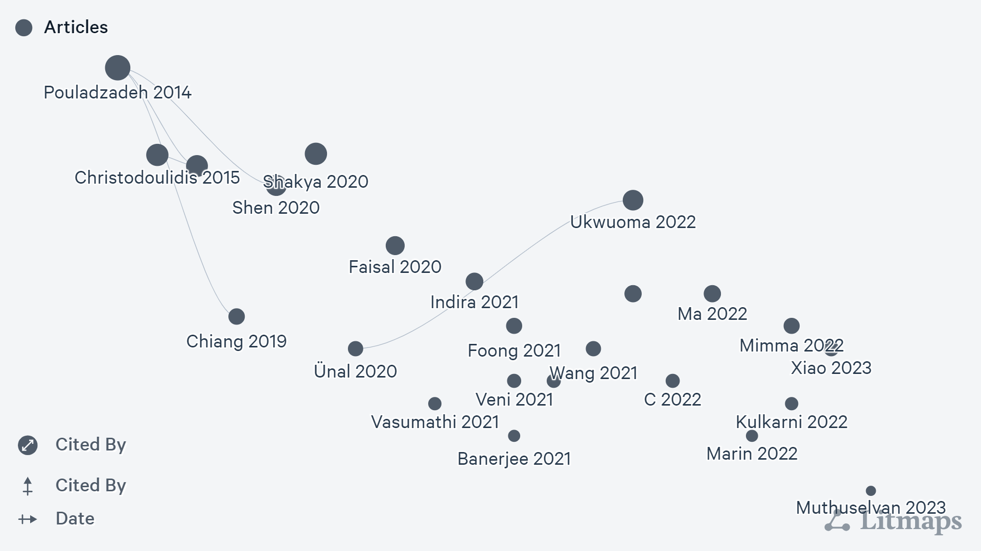

Slide 67
IDENTIFIED METRICS OF THE JOURNAL/CONFERENCE FOR ALL THE REFERENCES CONSIDERED

Slide 68
S.No | Title of the paper | Citation count | Type of Publication(Conference/Journal) | Name of the Journal / Conference | Cite score | Impact Factor | Quartile
1. | A Robust Approach Using Fuzzy Logic for the Calories Evaluation of Fruits | 2 | CONFERENCE | SPIN | 6.5 | 3.422 | Q1
2. | Image-based Fruit Recognition and Classification. | 245 | CONFERENCE | IEEE | 7.1 | 5.572 | Q1
3. | Fruit Detection and Recognition Based on Deep Learning for Automatic Harvesting: An Overview and Review | 11 | CONFERENCE | AGRONOMY 2023 | 6.5 | 3.422 | Q2
4. | Machine Learning Based Approach on Food Recognition and Nutrition Estimation | 10 | JOURNAL | SCIENCE DIRECT | 6.5 | 3.422 | Q2
5. | Deep Learning and Computer Vision for Estimating Date Fruits Type, Maturity Level, and Weight | 4 | JOURNAL | IEEE | 7.5 | 4.422 | Q2
6. | Classification of fruits using Convolutional Neural Network. | 21 | CONFERENCE | IEEE | 6.1 | 3.045 | Q2
7. | Convolutional Neural Network based Rotten Fruit Detection using ResNet50. | 12 | CONFERENCE | IEEE | 7.5 | 3.444 | Q1
8. | A review on fruit recognition and feature evaluation using CNN | 25 | CONFERENCE | SCIENCE DIRECT | 7.5 | 3.987 | Q1
9. | Deep learning accurately predicts food categories and nutrients based on ingredient statements | 9 | JOURNAL | SCIENCE DIRECT | 8.1 | 7.152 | Q1
10. | Fruits and Vegetables Recognition using YOLO | 1 | JOURNAL | IEEE | 5.4 | 3.447 | Q1
11. | Fruit-CNN: An Efficient Deep learning-based Fruit Classification and Quality Assessment for Precision Agriculture. | 22 | JOURNAL | IEEE | 6.5 | 3.422 | Q2
12. | Real Time Riped Fruit Detection using Faster R-CNN Deep Neural Network Models. | 19 | CONFERENCE | IEEE | 5.8 | 3.711 | Q1
13. | Fruit Classification using Optimized CNN | 6 | CONFERENCE | IEEE | 4.5 | 3.540 | Q1
14. | Fruit Freshness Detection Using CNN | 11 | JOURNAL | IEEE | 5.4 | 3.447 | Q2
15. | Food Calorie and Nutrition Analysis System based on Mask R-CNN. | 14 | CONFERENCE | IEEE | 6.1 | 3.052 | Q2

Slide 69
Evaluation Rubrics
Rubric Name | Weightage
Problem Statement/Introduction | 5
Motivation | 5
Dataset Analysis | 10
Related papers review | 30

Slide 70
THANK YOU

